Slide 1
Agenda for GEOG279/379 GIS & Map Comparison
October 25
Remind the Professor to start the video recording
Tom earns another eye
Discuss Assignment 8, Vector Variables, and Sins
October 27
Assignment 8 due at 4pm
Instructions for Proposal
November 1
Discuss Proposal ideas
November 3
Proposal due at 4pm

Slide 2

Another Mathematical Eye for Tom
Line 2893 should state that in Figure 11.1, the southwestern X vector has a magnitude of 8 and a direction of 0 degrees from north.

Slide 4
Assignment 8 rubric
The correct answer related to the components of mean absolute deviation for magnitude and direction is given. 35 points
2. The correct answers for the other two chapter 11 questions are given. 20 points
3. The correct answers for the four chapter 12 questions are provided. 40 points
Total = 95 points

Slide 5
Assignment 8
Submit one word document that gives your responses to the questions at the end of chapters 11 and 12.

Slide 6
What is Y minus X when Y=355 and X=5?

Slide 7
What is Y minus X when Y=355 and X=5?
How could Pontius get an answer of negative 10?

Slide 8
Circular direction variable showing a difference of 10 degrees in the counter clockwise direction through an interval that includes perfect north, where X = 5 degrees and Y = 355 degrees.

Slide 9
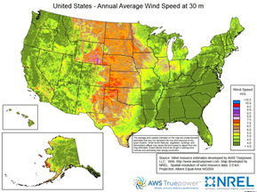
Map from Clark graduate in the Wind Industry

Slide 10
Difference in aspect maps that derive from different algorithms to compute aspect from elevation.

Slide 11
Chapter 11 Vector Variables
A vector variable has a magnitude and direction.
For geographical phenomenon, we define direction as number of degrees from north on the interval (-180°,180°].
The direction for Y minus the direction for X is on the interval (-180°,180°]. A negative difference means Y is counterclockwise from X. A positive difference means that Y is clockwise from X.

Slide 12
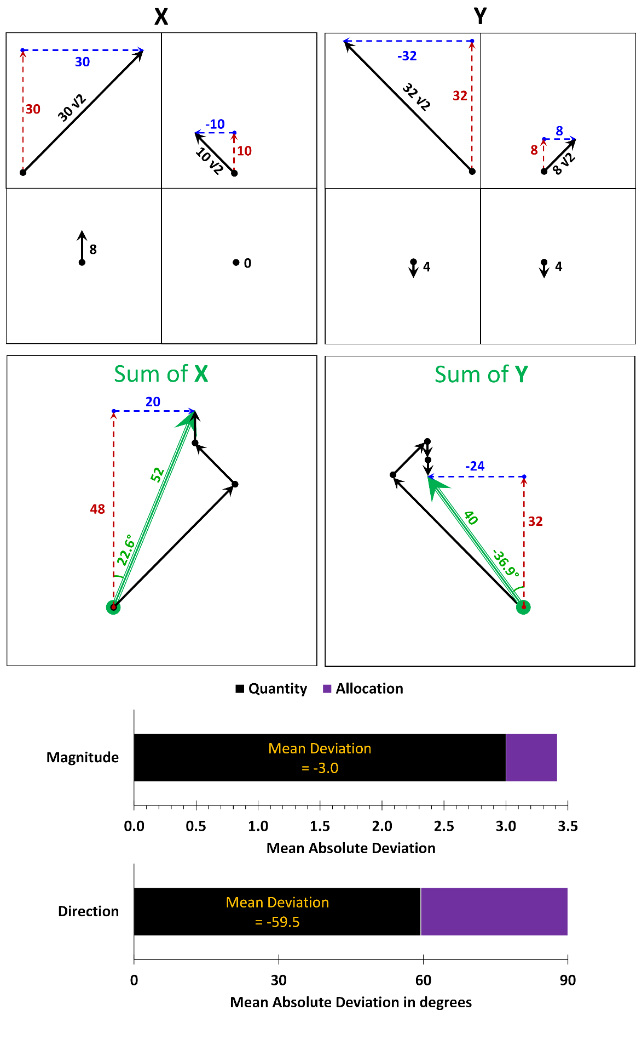
What is difference in magnitude and difference in direction for each of the four pixel pairs where we take Y minus X.

Slide 13
What is difference in magnitude and difference in direction for each of the four pixel pairs where we take Y minus X.
Difference Magnitude = 2√2
Direction = -90°

Slide 14
What is difference in magnitude and difference in direction for each of the four pixel pairs where we take Y minus X.
Difference Magnitude = -2√2
Direction = 90°
Difference
Magnitude = 2√2
Direction = -90°
Difference
Magnitude = -4
Direction = 180°
Difference Magnitude = 4
Direction = 0°

Slide 15
What is difference in magnitude and difference in direction for each of the four pixel pairs where we take Y minus X.
Mean Absolute Difference for
Magnitude = (2√2 + 2√2 + 4 + 4)/4 = √2+2 ≈ 3.41
Direction = (90+90+180 + 0)/4 = 90°
Difference
Magnitude = -2√2
Direction = 90°
Difference
Magnitude = 2√2
Direction = -90°
Difference
Magnitude = -4
Direction = 180°
Difference
Magnitude = 4
Direction = 0°

Slide 16
Mean is the sum of observation values divided by the number of observations. Use vector addition to compute sum for X and sum for Y?
Mean of X has
Magnitude = 52/4 = 13
Direction = 22.6°
Mean of Y has
Magnitude = 40/4 = 10
Direction = -36.9°
What is difference between Mean Y and Mean X?

Slide 17
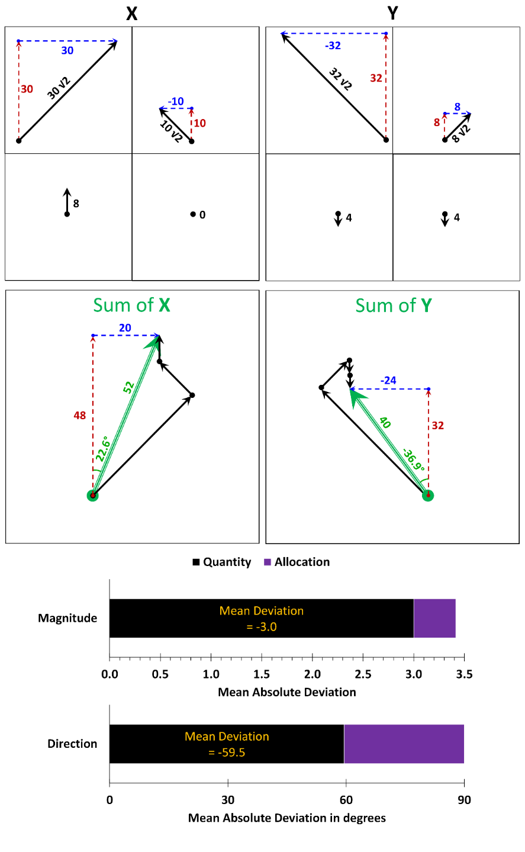
Mean Absolute Difference for
Magnitude = (2√2 + 2√2 + 4 + 4)/4 = √2+2 ≈ 3.41
Direction = (90+90+180 + 0)/4 = 90°
Differences between Mean Y and Mean X are
Magnitude = -3
Direction = -59.5°

Slide 18
What is difference in magnitude and difference in direction for each of the four pixel pairs where we take Y minus X.

Slide 19
Second discussion question
8 pointing south
zero vector

Slide 20
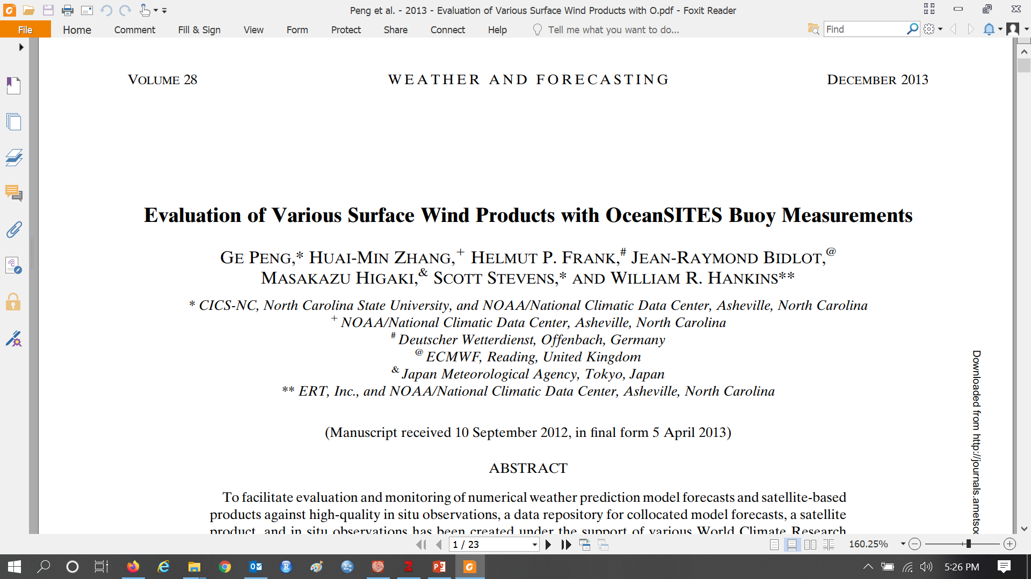

Slide 21
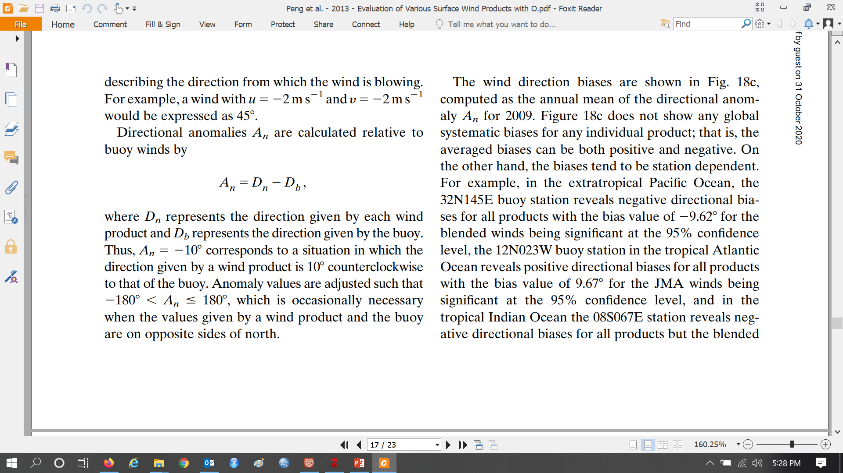

Slide 23
Aiyin wrote:
According to the paragraph just above the data section in page 1282, the (u,v) components mean zonal and meridional wind, I'm not familiar with the terminology, but I found a helpful definition from this site: http://colaweb.gmu.edu/dev/clim301/lectures/wind/wind-uv
For winds, the u wind is parallel to the x axis. A positive u wind is from the west. A negative u wind is from the east. The v wind runs parallel to the y axis. A positive v wind is from the south, and a negative v wind is from the north.
But I still haven't figure out why in the article the degree in their example is 45° instead of -135°, I might need more time to look into that.

Slide 24
From Ge Peng
Dear Aiyin,
Thank you very much for your interest in the paper.
It is due to the fact that meteorological wind direction is defined as the direction from which it originates, not where it is going.
Here is a class note on the differences between wind vector azimuth and meteorological wind direction:
http://tornado.sfsu.edu/geosciences/classes/m430/Wind/WindDirection.html
Hope it helps.
-- Peng

